Slide 1
What is a ‘DMP’ electoral system?
How would it work on PEI?
Why is it the ideal model?
Anna Keenan - anna.c.keenan@gmail.com - (902) 621 0341
Submission to Democratic Renewal Committee

Slide 2
DMP means...
Dual Member - Each voting district is represented by
2 local-candidate representatives
Mixed - Blends 2 voting principles: local plurality (popularity);
overall proportionality (representativeness)
Proportional - The overall result is proportional, so if 45% of
Island voters choose the ‘Cat Party’, the Cats
gain 45% of the seats in the legislature.

Slide 3
What are the weaknesses of other electoral systems?

Slide 4
First-Past-The-Post (FPTP) ignores many voters.
In FPTP, very large numbers of voters - often a majority - are politically disenfranchised. There is no theoretical upper limit.
In Canadian Federal elections from 1980 to 2006, an average of 49% of votes were ‘wasted’ - having no influence on the district results, or the overall composition of the Federal legislature.
(Ref: The Politics of Voting, Dennis Pilon)
Disenfranchisement drives cynicism about the importance of voting, and leads directly to citizens ‘Voting Strategically’, instead of voting for their party of choice, which most closely matches their values.
This disproportionately favours two major parties, and excludes minority voices.

Slide 5
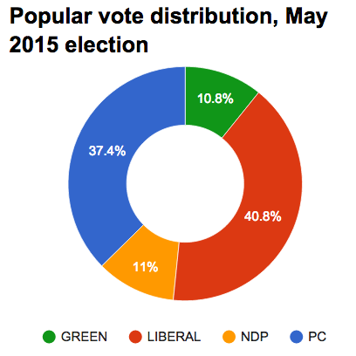
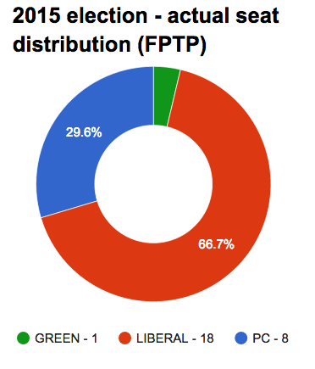
First-Past-The-Post (FPTP) ignores many voters.
vs

Slide 6
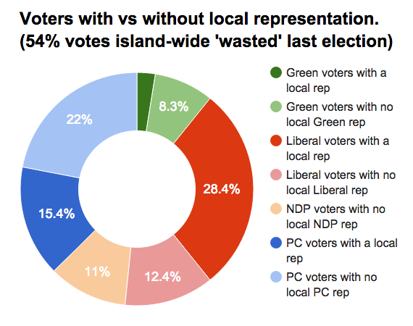
First-Past-The-Post (FPTP) ignores many voters.
54% of voters in the last PEI election had their votes ‘wasted’.
That is, the election result would have been exactly the same if they had not participated at all.

Slide 7
Proportional Representation (PR) is the ideal...
Every citizen’s vote counts equally - the composition of the legislature matches the values of the broader public.
‘Wasted votes’ are minimised. Voter cynicism decreases, strategic voting disappears.
Higher diversity within parliament means parties need to learn to cooperate. Civility in politics increases, partisan polarisation and ‘negative campaigning’ reduce dramatically.
80 countries around the world already use some form of PR.

Slide 8
… but specific PR models have problems,
… which prevent people (even those who dislike FPTP) from supporting positive change.
MMP Mixed-Member Proportional
A more-complex ballot
Half the legislature is selected from a “Party List”, instead of from locally-known and locally-accountable candidates
STV Single Transferable Vote
Extremely complex ballot
Tension: ‘global proportionality’ is traded off against ‘local representativeness’.

Slide 9
Concerns with specific PR models often leads to consideration of the “Alternative Vote” (AV)...
… but this is a distraction from the true goal: Proportional Representation.
a.k.a. “Instant Runoff” or “Preferential Voting” (a misnomer)
Leads to non-proportional outcomes: up to 49% of votes can be wasted.
Not all votes are equal - some voters have their 1st-preference votes counted. But others’ 1st preferences don’t matter: only their 2nd or even 3rd preference counts.
Slightly better than FPTP, but not good enough.

Slide 10
DMP is a newly-designed PR model with many advantages
All the advantages of PR, but relying on 100% local candidates.
Unlike MMP, no ‘party lists’ are used, and no two-tier legislature is created.
Unlike STV, local representation and proportionality are not traded-off. In fact, it’s the opposite: the smaller the districts, the more proportional the overall result.
Unlike both major PR systems, the ballot paper is very simple.
In PEI, only 3.6% of votes could be wasted, at most, if we used DMP to elect a 28-seat legislature (14 districts), with 4 parties contesting every seat.

Slide 11
So how would DMP work on PEI?
The example in the following slides uses the following assumptions, which I would recommend if DMP were to be applied in PEI:
The legislature should be kept at the same approximate size it is today, so we would use 14 dual-member districts. (Resulting in a 28-seat legislature.)
The simplest possible ballot paper design should be used: a single-choice ballot.
(With DMP, it is alternatively possible to use a “Fractional Ballot”. This would be substantially more complicated for voters, without adding significant democratic advantage, so is not recommended.)

Slide 12
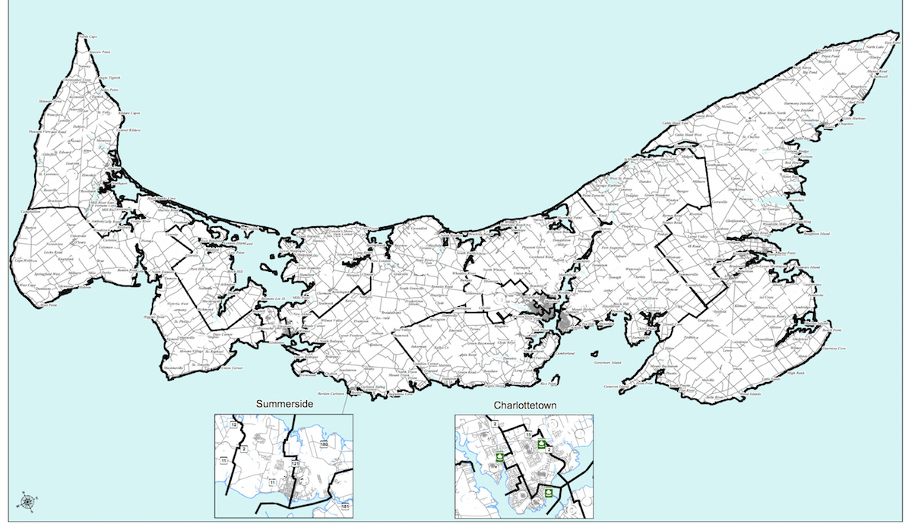
The districts...
The map would look something like this.
Each district would have roughly 6000 voters,
and two local representatives.
*NB: this map is for illustrative purposes only. Elections PEI would need to determine new boundaries under DMP.

Slide 13
The ballot paper would look something like this…
P.E.I. Election 2015
District G, Avonlea-White Sands
Vote by putting a single “X” in the circle beside the option you most support.
X
Parties may nominate up to
2 candidates per district.
Independent candidates may also run.
When a party wins 1 of the 2 seats
for this district, only their first-listed candidate is selected.
CAT PARTY
1. Maud Montgomery
2. Matthew Cuthbert
DOG PARTY
1. Charlie Sloane
2. Anne Shirley
LIZARD PARTY
1. Marilla Cuthbert
2. Gilbert Blythe
RABBIT PARTY
1. Peter Blewett
2. Diana Barry
John Blythe (Independent)

Slide 14
1st seats per district are simply allocated by plurality
14 DISTRICTS | 1st Seat | 2nd Seat
A | PC | ?
B | LIBERAL | ?
C | PC | ?
D | PC | ?
E | LIBERAL | ?
F | LIBERAL | ?
G | LIBERAL | ?
H | LIBERAL | ?
I | LIBERAL | ?
J | PC | ?
K | PC | ?
L | LIBERAL | ?
M | LIBERAL | ?
N | LIBERAL | ?
So, the most popular candidate in every district joins the legislature. Yay!
Half of the 28 seats are now allocated.
In this example, using real data from the 2015 Provincial Election:
Liberals win 9 seats
Progressive Conservatives win 5 seats

Slide 15

To complete the legislature, each district will also be represented by a second local candidate.
The 2nd seats are allocated to make the province-wide outcome truly proportional.
 | GREEN | LIB | NDP | PC | TOTALS
PERCENT OF POPULAR VOTE | 10.8% | 40.8% | 11.0% | 37.4% | 100%
WHOLE # SEATS DESERVED | 3 | 11 | 3 | 10 | 27
REMAINDER | 0.02 | 0.43 | 0.07 | 0.47 | 1
TOTAL SEATS TO BE ALLOCATED | 3 | 11 | 3 | 11 | 28
1st SEATS ALREADY GRANTED | 0 | 9 | 0 | 5 | 14
2nd SEATS REQUIRED | 3 | 2 | 3 | 6 | 14
“For a proportional result, we now need 3 Greens, 2 more Liberals, 3 NDP reps, and 6 more PCs.”
*This example uses real data from the 2015 Provincial Election

Slide 16

But which districts should those 3 Greens, 2 Liberals, 3 NDP reps and 6 PCs come from?
Parties are assigned their deserved seats where they have had their strongest relative support. The 2nd-place candidate in each district is elected as frequently as possible.
In most districts, this results in local representatives from 2 different parties.
“My district, B, is represented by a Liberal AND a PC! They were our district’s first and second preferences.”

Slide 17
But which districts should those 3 Greens, 2 Liberals, 3 NDP reps and 6 PCs come from?
14 DISTRICTS | 1st Seat | 2nd Seat | District rank for 2nd seat
A | PC | NDP | 4
B | LIBERAL | PC | 2
C | PC | NDP | 4
D | PC | LIBERAL | 2
E | LIBERAL | PC | 2
F | LIBERAL | PC | 2
G | LIBERAL | GREEN | 4
H | LIBERAL | PC | 2
I | LIBERAL | GREEN | 2
J | PC | LIBERAL | 2
K | PC | GREEN | 4
L | LIBERAL | PC | 2
M | LIBERAL | NDP | 4
N | LIBERAL | PC | 2
“My district, B, is represented by a Liberal AND a PC! They were our district’s first and second preferences.”
*Uses real data from the
2015 Provincial Election.
Full details available on request

Slide 18
What is the one weakness of the DMP model?
In a minority of districts, the 2nd-seat representative will not be the “2nd most-preferred” local candidate. Instead, a minority of districts will be represented by their “1st and 3rd” or “1st and 4th-ranked” candidates.
However, this is a relatively minor issue for two reasons:
It will not affect the same districts in every election - no group of voters is permanently marginalised under DMP.
Citizen’s votes weren’t wasted - every citizen’s first preference vote is still reflected in the overall composition of the legislature.

Slide 19


What is the one weakness of the DMP model?
Hmmmm. We in District A have a PC and an NDP representative, even though the PCs and the Liberals were the most popular parties locally.
And the NDP won the second seat here in District A fairly, because they had support of 11% of voters spread across the Island, but their vote was relatively stronger here.
But I feel OK about that, because this district’s votes for the Liberals contributed to them winning the second seats for Districts D and J.

Slide 20
Some interesting side-effects of DMP...
Unless one party has a super-majority, most districts will end up with representatives from two parties, rather than just one. This encourages local-level inter-partisan communication and cooperation.
“My district, B, is represented by a Liberal AND a PC! They’ll need to learn how to get along!

Slide 21
Some interesting side-effects of DMP...
Majority governments with absolute power would be less common. Minority or coalition governments would be expected and normalised, with more inter-party negotiation, and much greater transparency.
Under DMP, the 2015 election results would have been:
11 Liberals (with 40.8% of the popular vote)
11 PCs (with 37.4%)
3 Green (with 10.8%)
3 NDP (with 11%)
The Lieutenant-Governor would likely have requested the Liberals form government, as they led the popular vote.
In this example, one can imagine a Liberal minority government negotiating with the other parties for support on a bill-by-bill basis.
Parties will need to learn how to get along in the legislature too!
More inter-negotiation is good for democratic transparency and accountability.

Slide 22
Some interesting side-effects of DMP...
‘Regionalist’ rhetoric (ie, ‘city vs country’) decreases, because DMP does not over-reward regionally-concentrated support, nor does it punish diffuse provincial support.
There is no incentive for gerrymandering (manipulating) district borders, as it will have no significant effect on the overall composition of the legislature.
Even though coalition or minority governments will become more common, there is no additional incentive for parliamentary dissolution or calling early elections, so stability won’t be affected.

Slide 23
For more info, get in contact...
Anna Keenan BSc(Math), BA(Economics)
is a resident of New Glasgow, PEI. She has been inspired by the work of Sean Graham to promote the DMP model for the Island and for Canada, and is available for more in-depth consultation.
anna.c.keenan@gmail.com - (902) 621 0341
Sean Graham BSc (Political Science), BSc (Math), University of Alberta,
is the creator of the DMP electoral model. His electoral systems research project was funded by the University of Alberta’s Undergraduate Research Initiative. See his full papers amongst the submissions to the PEI Special Committee for Democratic Renewal.
smg1@ualberta.ca

